Slide 1
1 Corinthians 14:1-6 & 20-40

Slide 2
14 Pursue love, and earnestly desire the spiritual gifts, especially that you may prophesy. ² For one who speaks in a tongue speaks not to men but to God; for no one understands him, but he utters mysteries in the Spirit. ³ On the other hand, the one who prophesies speaks to people for their upbuilding and encouragement and consolation. ⁴ The one who speaks in a tongue builds up himself, but the one who prophesies builds up the church. ⁵ Now I want you all to speak in tongues, but even more to prophesy. The one who prophesies is greater than the one who speaks in tongues, unless someone interprets, so that the church may be built up.

Slide 3
⁶ Now, brothers, if I come to you speaking in tongues, how will I benefit you unless I bring you some revelation or knowledge or prophecy or teaching?
.................
Continuing V20-40

Slide 4
²⁰ Brothers, do not be children in your thinking. Be infants in evil, but in your thinking be mature. ²¹ In the Law it is written, “By people of strange tongues and by the lips of foreigners will I speak to this people, and even then they will not listen to me, says the Lord.” ²² Thus tongues are a sign not for believers but for unbelievers, while prophecy is a sign not for unbelievers but for believers. ²³ If, therefore, the whole church comes together and all speak in tongues, and outsiders or unbelievers enter, will they not say that you are out of your minds?

Slide 5
²⁴ But if all prophesy, and an unbeliever or outsider enters, he is convicted by all, he is called to account by all, ²⁵ the secrets of his heart are disclosed, and so, falling on his face, he will worship God and declare that God is really among you.
²⁶ What then, brothers? When you come together, each one has a hymn, a lesson, a revelation, a tongue, or an interpretation. Let all things be done for building up. ²⁷ If any speak in a tongue, let there be only two or at most three, and each in turn, and let someone interpret.

Slide 6
²⁸ But if there is no one to interpret, let each of them keep silent in church and speak to himself and to God. ²⁹ Let two or three prophets speak, and let the others weigh what is said. ³⁰ If a revelation is made to another sitting there, let the first be silent. ³¹ For you can all prophesy one by one, so that all may learn and all be encouraged, ³² and the spirits of prophets are subject to prophets. ³³ For God is not a God of confusion but of peace.
As in all the churches of the saints, ³⁴ the women should keep silent in the churches. For they are not permitted to speak, but should be in submission, as the Law also says.

Slide 7
³⁵ If there is anything they desire to learn, let them ask their husbands at home. For it is shameful for a woman to speak in church.
³⁶ Or was it from you that the word of God came? Or are you the only ones it has reached? ³⁷ If anyone thinks that he is a prophet, or spiritual, he should acknowledge that the things I am writing to you are a command of the Lord. ³⁸ If anyone does not recognize this, he is not recognised. ³⁹ So, my brothers, earnestly desire to prophesy, and do not forbid speaking in tongues. ⁴⁰ But all things should be done decently and in order.

Slide 8
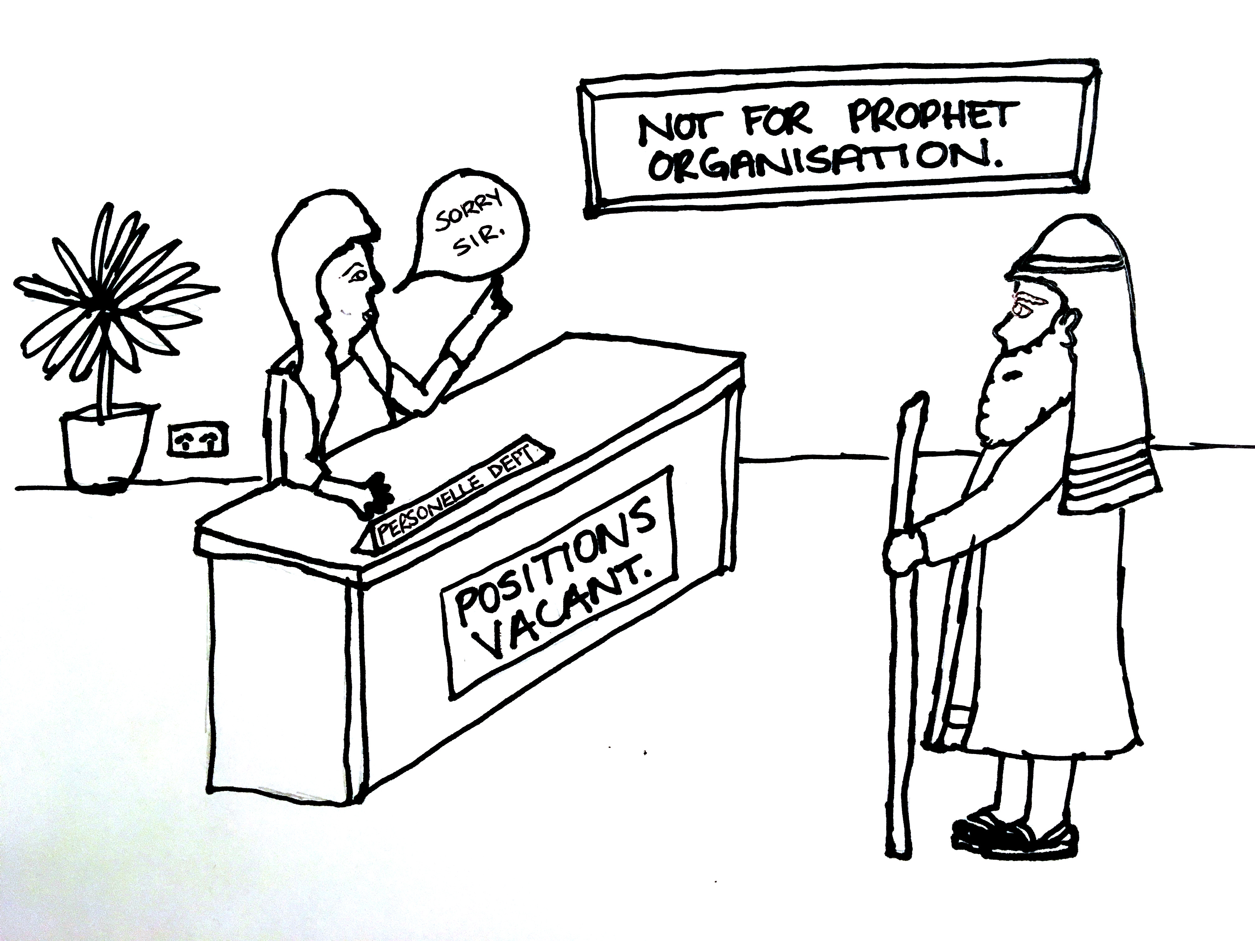

Slide 9
The gift of prophecy will pass away...
But only when Jesus returns
4 Biblical reasons why the Gift of Prophecy continues today:
We are living in the last days
Acts 2:¹⁷ "`In the last days, God says, I will pour out my Spirit on all people. Your sons and daughters will prophesy, your young men will see visions, your old men will dream dreams. ¹⁸ Even on my servants, both men and women, I will pour out my Spirit in those days, and they will prophesy.

Slide 10
The gift of prophecy will pass away...
But only when Jesus returns
4 Biblical reasons why the Gift of Prophecy continues today:
We are living in the last days
At Pentecost, the Holy Spirit came upon all disciples of Jesus
Given gifts of the Spirit (including prophecy)
The Revelation of Jesus Christ shows Prophecy continuing to the end
Warned to watch out for false prophets (distinguish between a true prophet and a false prophet)
The Commands of God (in the New Testament)
Eagerly desire Spiritual Gifts – Especially Prophecy
Do not despise prophecy

Slide 11
Prophecy is a gift we should “eagerly desire”
For the benefit of others Upbuilding; Encouragement [urging on]; Consolation
True prophecy, is God speaking through His prophets
A sign for Believers (not unbelievers)
²⁴ But if all prophesy, and an unbeliever or outsider enters, he is convicted by all, he is called to account by all, ²⁵ the secrets of his heart are disclosed, and so, falling on his face, he will worship God and declare that God is really among you.

Slide 12
Prophecy is a gift we should “eagerly desire”
For the benefit of others Upbuilding; Encouragement [urging on]; Consolation
True prophecy, is God speaking through His prophets
A sign for Believers (not unbelievers)
Unbelievers turning to God are a great encouragement for believers
Prophecy is more than “preaching”
Often combined with preaching
Sometimes a revelation of His particular call of an individual or a church to a specific ministry
When God wills, it can give us insight into the future

Slide 13
Acts 11:²⁷ Now in these days prophets came down from Jerusalem to Antioch. ²⁸ And one of them named Agabus stood up and foretold by the Spirit that there would be a great famine over all the world (this took place in the days of Claudius). ²⁹ So the disciples determined, every one according to his ability, to send relief to the brothers living in Judea. ³⁰ And they did so, sending it to the elders by the hand of Barnabas and Saul.

Slide 14
Acts 21:¹⁰ While we were staying for many days, a prophet named Agabus came down from Judea. ¹¹ And coming to us, he took Paul’s belt and bound his own feet and hands and said, “Thus says the Holy Spirit, ‘This is how the Jews at Jerusalem will bind the man who owns this belt and deliver him into the hands of the Gentiles.’ ”
¹² When we heard this, we and the people there urged him not to go up to Jerusalem. ¹³ Then Paul answered, “What are you doing, weeping and breaking my heart? For I am ready not only to be imprisoned but even to die in Jerusalem for the name of the Lord Jesus.” ¹⁴ And since he would not be persuaded, we ceased and said, “Let the will of the Lord be done.”
¹⁵ After these days we got ready and went up to Jerusalem.

Slide 15
Prophecy is a gift we should “eagerly desire”
For the benefit of others Upbuilding; Encouragement [urging on]; Consolation
True prophecy, is God speaking through His prophets
A sign for Believers (not unbelievers)
Unbelievers turning to God are a great encouragement for believers
Prophecy is more than “preaching”
Often combined with preaching
Sometimes a revelation of His particular call of an individual or a church to a specific ministry
When God wills, it can give us insight into the future
Prophecy – an encouragement to the Spiritual person – not the fleshly
Godly prophecy won’t always tell us stuff that appeals to the flesh
The gift of Prophecy is not to be taken lightly
Only to be shared if you are certain it is from God

Slide 16
^{1 Corinthians 14:29} Let two or three prophets speak, and let the others weigh what is said.
1 Thessalonians 5:¹⁹ Do not quench the Spirit. ²⁰ Do not despise prophecies, ²¹ but test everything; hold fast what is good. ²² Abstain from every form of evil.

Slide 17
Prophecy is a gift we should “eagerly desire”
For the benefit of others Upbuilding; Encouragement [urging on]; Consolation
True prophecy, is God speaking through His prophets
A sign for Believers: Unbelievers turning to God – a great encouragement
Prophecy is more than “preaching”
Sometimes a revelation of His particular call to a specific ministry
When God wills, it can give us insight into the future
Prophecy – an encouragement to the Spiritual person – not the fleshly
Godly prophecy won’t always tell us stuff that appeals to the flesh
The gift of Prophecy is not to be taken lightly
Only to be shared if you are certain it is from God
Guarding against false prophecy - test everything; weigh up what is said
Often combined with preaching
Godly prophecy never contradicts Scripture
Prophecies from God will be consistent
A prophet is tested by the content of his character (fruit of the Spirit)

Slide 18
Matthew 7:¹⁵ “Beware of false prophets, who come to you in sheep’s clothing but inwardly are ravenous wolves. ¹⁶ You will recognise them by their fruits. Are grapes gathered from thornbushes, or figs from thistles? ¹⁷ So, every healthy tree bears good fruit, but the diseased tree bears bad fruit. ¹⁸ A healthy tree cannot bear bad fruit, nor can a diseased tree bear good fruit. ¹⁹ Every tree that does not bear good fruit is cut down and thrown into the fire. ²⁰ Thus you will recognise them by their fruits.
²¹ “Not everyone who says to me, ‘Lord, Lord,’ will enter the kingdom of heaven, but the one who does the will of my Father who is in heaven. ²² On that day many will say to me, ‘Lord, Lord, did we not prophesy in your name, and cast out demons in your name, and do many mighty works in your name?’ ²³ And then will I declare to them, ‘I never knew you; depart from me, you workers of lawlessness.’

Slide 19
Prophecy is a gift we should “eagerly desire”
For the benefit of others Upbuilding; Encouragement [urging on]; Consolation
True prophecy, is God speaking through His prophets
A sign for Believers: Unbelievers turning to God – a great encouragement
Prophecy is more than “preaching”
Sometimes a revelation of His particular call to a specific ministry
When God wills, it can give us insight into the future
Prophecy – an encouragement to the Spiritual person – not the fleshly
Godly prophecy won’t always tell us stuff that appeals to the flesh
The gift of Prophecy is not to be taken lightly
Only to be shared if you are certain it is from God
Guarding against false prophecy - test everything; weigh up what is said
Often combined with preaching
Godly prophecy never contradicts Scripture
Prophecies from God will be consistent
A prophet is tested by the content of his character (fruit of the Spirit)
Those with the Gift of Discernment can identify false prophets (God reveals falseness)
False prophets may be demonic or use the skill of ‘cold reading’ to pretend they know
Satan perverts God’s good gift of prophecy. Don’t be scared of the true gift

